Slide 1
This slide is hidden.
Insert the starting slides after this slide

Slide 2


Welcome to St Michael’s
First Sunday of Lent
Year B
You have entered a
SACRED SPACE
– a SACRED TIME...
Please ensure all mobile phones are switched off.
Please be respectfully quiet
as we prepare for our celebration.

Slide 3
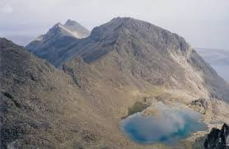
Jesus took with him Peter and James and John and led them up a high mountain where they could be alone …

Slide 4
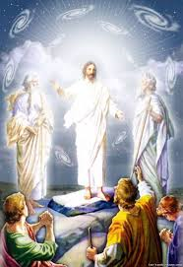
There in their presence Jesus was transfigured: his clothes became dazzlingly white…

Slide 5
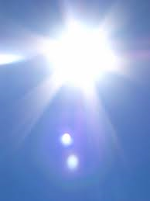
… and there came a voice from the cloud
'This is my Son, the Beloved. Listen to him...

Slide 6
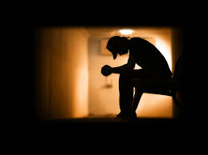
How could I more faithfully ʻlistenʼ to Jesus in prayer this Lent?

Slide 7
Please Stand

Slide 8
This slide is hidden.
Insert the Entrance Hymn after this slide

Slide 9
Only by grace
Only by grace can we enter
Only by grace can we stand
Not by our human endeavour
But by the blood of the lamb

Slide 10
Into your presence you call us
Call us to come
Into your presence you draw us
Now by your grace we come
Now by your grace we come

Slide 11
Lord if you mark our transgressions
Who will stand
Thanks to your grace we are cleansed
By the blood of the lamb

Slide 12
Only by grace can we enter
Only by grace can we stand
Not by our human endeavour
But by the blood of the lamb

Slide 13
Into your presence you call us
Call us to come
Into your presence you draw us
Now by your grace we come
Now by your grace we come

Slide 15
Confiteor
I confess to almighty God
And to you, my brothers and sisters,
That I have greatly sinned
In my thoughts and in my words

Slide 16
In what I have done
And in what I have failed to do,
Through my fault,
Through my fault,
Through my most grievous fault;

Slide 17
Therefore I ask blessed Mary ever-Virgin,
All the Angels and Saints,
And you, my brothers and sisters,
To pray for me to the Lord our God.

Slide 19
Kyrie eleison
Kyrie eleison (2)
Christe eleison (2)
Kyrie eleison (2)

Slide 21
Responsorial Psalm
I will walk in the presence of the Lord, in the land of the living

Slide 23
Alleluia
Alleluia, alleluia,
alleluia, alleluia

Slide 24
Alleluia
Praise and honour to you Lord Jesus Christ (2)

Slide 26
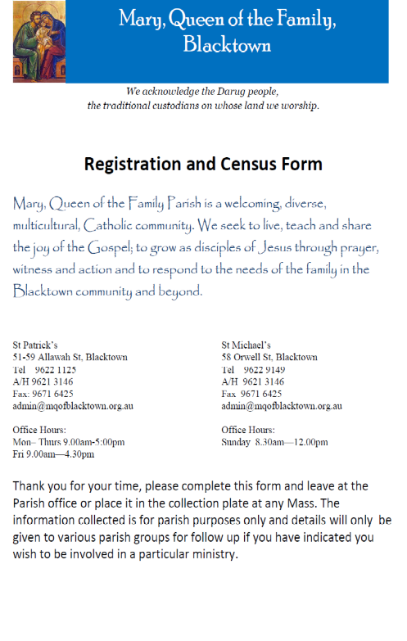
OUR RECORDS NEED UPDATING!
Every family in our parish requested
to complete a census form this
weekend.
Forms and pens are available
on your seat. We will now take a few moments to fill in your form!

Slide 27

Thank your for your help!
You may take home the pen – our thank you gift to you!
Could the collectors please collect completed form. Many thanks

Slide 28
Apostles Creed
I believe in God,
the Father almighty,
Creator of heaven and earth,
and in Jesus Christ, his only Son, our Lord,
(At the words that follow, up to and including the Virgin Mary, all bow.)

Slide 29
who was conceived by the Holy Spirit,
born of the Virgin Mary,
suffered under Pontius Pilate,
was crucified, died and was buried;
he descended into hell;

Slide 30
on the third day he rose again from the dead;
he ascended into heaven,
and is seated at the right hand of God the Father almighty;

Slide 31
from there he will come to judge the living and the dead.
I believe in the Holy Spirit,
the holy catholic Church,

Slide 32
the communion of saints,
the forgiveness of sins,
the resurrection of the body,
and life everlasting.
Amen.

Slide 34
This slide is hidden.
Insert the Offertory Hymn after this slide.

Slide 35
First Collection
This collection goes to the Bishop
for the support of the Diocese.
Thank you for your contribution

Slide 36
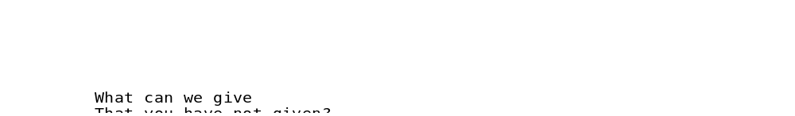
Lord, I offer my life
All that I am, all that I have
I lay them down before you, oh Lord
All my regrets, all my acclaims
The joy and the pain,
I'm making them yours

Slide 37
Lord, I offer my life to you
Everything I've been through
Use it for your glory

Slide 38
Lord I offer my days to you
Lifting my praise to you
As a pleasing sacrifice
Lord I offer you my life

Slide 39
Things in the past, things yet unseen
Wishes and dreams
that are yet to come true
All of my hopes, all of my plans
My heart and my hands are lifted to you

Slide 40
Lord, I offer my life to you
Everything I've been through
Use it for your glory

Slide 41
Lord I offer my days to you
Lifting my praise to you
As a pleasing sacrifice
Lord I offer you my life

Slide 42
What can we give that you have not given?
And what do we have
That is not already yours?
All we possess are these lives we're living
That's what we give to you, Lord

Slide 43
Lord, I offer my life to you
Everything I've been through
Use it for your glory

Slide 44
Lord I offer my days to you
Lifting my praise to you
As a pleasing sacrifice
Lord I offer you my life

Slide 46
Priest: Pray my brothers and sisters,
that my sacrifice and yours may be
acceptable to God, the almighty Father.
All: May the Lord accept the sacrifice
at your hands for the praise and glory of his name, for our good and the good of all his holy Church.

Slide 47
Priest: The Lord be with you.
All: And with your spirit.
Priest: Lift up your hearts.
All: We lift them up to the Lord.

Slide 48
Priest: Let us give thanks to the
Lord our God.
All: It is right and just.

Slide 50
Holy
Holy, Holy, Holy Lord God of hosts,
Heaven and earth are full of your glory. Hosanna in the highest
Blessed is he who comes
in the name of Lord,
Hosanna in the highest.

Slide 52
Memorial acclamation
Save us saviour of the world,
For by your cross and resurrection,
You have set us free

Slide 53
Memorial acclamation
When we eat this bread
And drink this cup
We proclaim your death O Lord
Until you come again

Slide 54
Memorial acclamation
We proclaim your death O Lord
And profess your resurrection
Until you come again

Slide 56
Amen
Amen, amen, amen, amen.
Amen, amen, amen, amen.

Slide 58
Priest: The Lord be with you.
All: And with your spirit

Slide 60
Peace
May the peace of the Lord be with you
With your friends and your family too
Let it be, let it grow
And everywhere you go
May the peace of the Lord follow you

Slide 61
Lamb of God
Lamb of God, lamb of God
You take away the sins of the world
Have mercy on us, lamb of God

Slide 62
Lamb of God, lamb of God
You take away the sins of the world
Have mercy on us, lamb of God

Slide 63
Lamb of God, lamb of God
You take away the sins of the world
Grant us, grant us peace

Slide 65
Priest: Behold the Lamb of God, behold him
who takes away the sins of the world.
Blessed are those called to the supper of the Lamb.
All: Lord, I am not worthy
that you should enter under my roof,
but only say the word
and my soul shall be healed.

Slide 66
This slide is hidden.
Insert the Communion Hymns after this slide.

Slide 67
In love for me
This is my body broken for you
Bringing you wholeness making you free
Take it and eat it, and when you do
Do it in love for me

Slide 68
This is my blood poured out for you
Bringing forgiveness, making you free
Take it and drink it, and when you do
Do it in love for me

Slide 69
This is my body broken for you
Bringing you wholeness making you free
Take it and eat it, and when you do
Do it in love for me

Slide 70
This is my blood poured out for you
Bringing forgiveness, making you free
Take it and drink it, and when you do
Do it in love for me
Do it in love for me

Slide 71
I worship you
When I look into your holiness
When I gaze into your loveliness
When all things that surround
Become shadows in the light of You

Slide 72
When I've found the joy of reaching your heart
When my will becomes enthralled in your love
When all things that surround
Become shadows in the light of You

Slide 73
I worship You, I worship You
The reason I live is to worship You
I worship You, I worship You
The reason I live is to worship You

Slide 74
In moments like these
In moments like these I sing out a song,
I sing out a love song to Jesus.
In moments like these I sing out a song,
I sing out a love song to the Lord....

Slide 75
Singing I love you Lord
Singing I love you Lord
Singing I love you Lord
I love you.

Slide 77
This slide is hidden.
The next slide can be used for videos.
Insert the video into the slide.

Slide 78
Second Collection
What you contribute now
is for the support of our
parish and its mission.
Thank you for your generosity

Slide 79

MQOF SACRAMENTAL PROCESS 2015
RECONCILIATION
EUCHARIST
CONFIRMATION
Registrations closing
28 February!

Slide 80


Slide 81
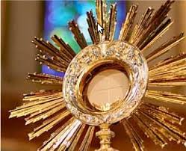
24 HOURS
WITH THE LORD
March 13-14
St Patrick’s Church – Allawah St
Commences 6.30pm Friday 13 March
Includes Stations of the Cross + Mass (Friday)
Reconciliation 9.30am -10.30am Saturday
concludes with 5.30pm Vigil Mass
Saturday 14 March

Slide 82


Vinnies Pantry
      Pasta sauce
      2mins noodles
      Sugar
      Tinned Soup
THANK YOU FOR YOUR GENEROUS SUPPORT
JEAN & BETTY’S BUS TRIPS
4 DAY TRIP TO BRIGHT
10th –14th March $620 (Must have 35 people) ring Jean 0425 251 754 or 99203401 as soon as possible to reserve your place.

Slide 83
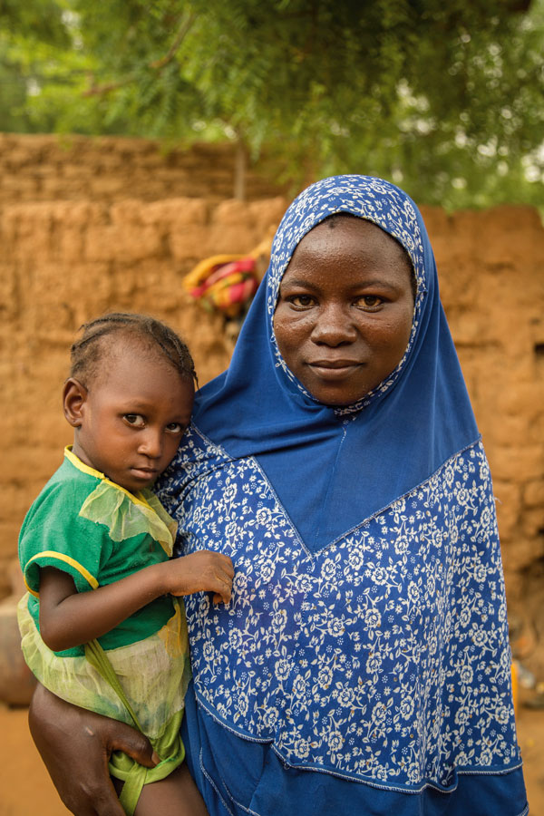
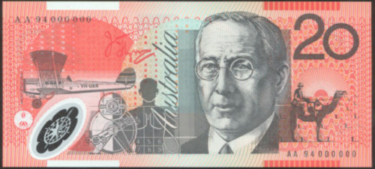
PROJECT COMPASSION

Slide 84


Celebrating Lent, Holy Week and Easter as one parish…
www.mqofblacktown.org.au
    www.facebook.com/blacktowncatholics
@mqofblacktown

Slide 86
Priest: The Lord be with you.
All: And with your spirit.

Slide 88
This slide is hidden.
Insert the Recessional Hymns after this slide.

Slide 89
Be exalted
I will give thanks to thee,
O Lord, among the people,
I will sing praises to thee,
Among the nations.

Slide 90
For thy steadfast love is great,
Is great to the heavens,
And thy faithfulness,
Thy faithfulness to the clouds.

Slide 91
Be exalted, O God, above the heavens,
Let thy Glory be over all the earth.
Be exalted, O God, above the heavens
Let thy Glory be over all the earth

Slide 92
It is good to thank you, Lord,
And to praise your name with music
To proclaim your love and mercy in the morning

Slide 93
For your deeds have made me glad,
At your works I shout in triumph
Yes, how wonderful and how marvelous
Are your designs.

Slide 94
Be exalted, O God, above the heavens,
Let thy Glory be over all the earth.
Be exalted, O God, above the heavens
Let thy Glory be over all the earth

Slide 95
Let thy glory, let thy glory
Let they glory be over all the earth

Slide 96
This slide is hidden.
Insert the final slide here.

